Slide 1
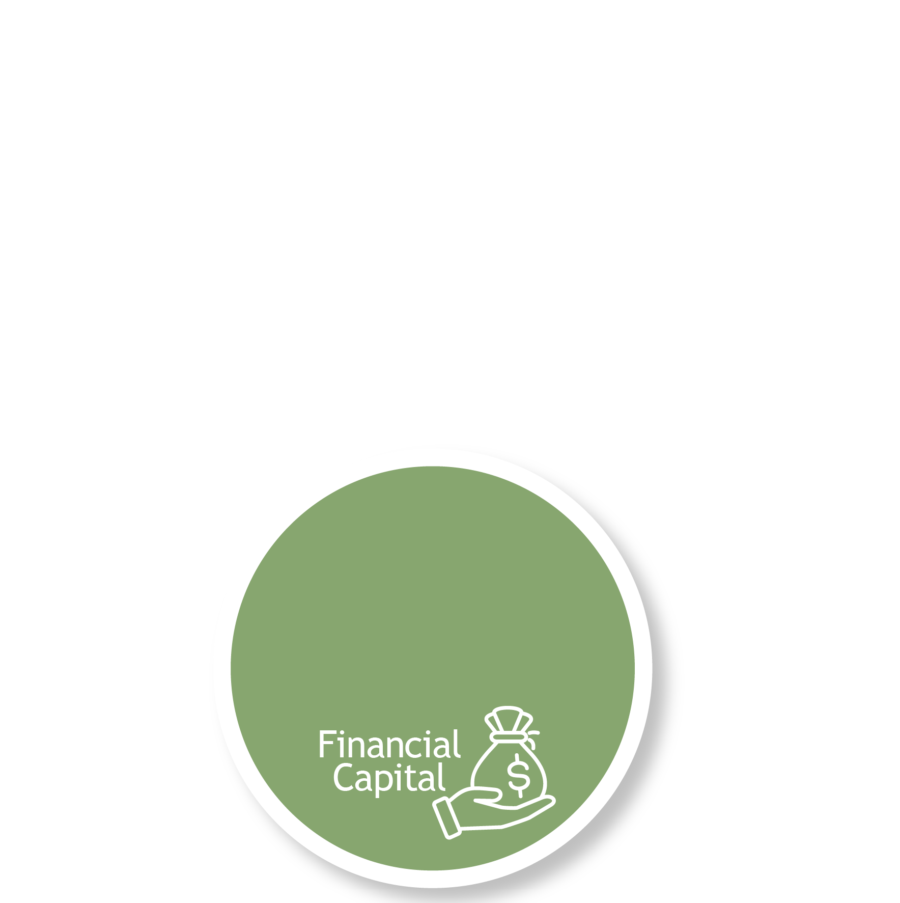

The Essential Answers Builder
LIVING THE BEST LIFE POSSIBLE…
…with the money you have, longer and larger than you ever thought possible is what we call Lifetime Total Wealth™.
Sometimes, if you feel your financial advisor is too heavily focused on your financial capital, you may also feel your opportunities to have them understand how you define a successful, meaningful, and purposeful life are limited.
The Essential Answers Builder can help you answer these essential questions for yourself, and it can give you what’s needed to engage advisors in a conversation about your definition of Lifetime Total Wealth™.
Because we believe questions are the answer, we developed follow up questions to help you answer our Five Essential Questions.
(NOTE: This exercise is deeply probing and difficult to complete in one sitting… if you feel at all overwhelmed, take your time, let things percolate and remember we are here to help.)
Let’s get started.
*Being You means having the freedom to joyfully pursue a life filled with purpose and significance.
“The beginner chases the right answers. The master chases the right questions.”
What are you most passionate about in life?
Who is most important to you?
What do you want for them?
What do you want from them?
What groups, institutions or causes in your community do you value the most?
What contribution are you making (or could be making) to your community that is meaningful to you and making a difference for others?
What activity makes you the happiest?
What activities give you energy and confidence?
When are you most comfortable?
Who do you want to be known as?
What do you want to be remembered for?
The Lifetime Total Care Journey™
Live the best life possible with the money you have, longer and larger than you ever thought possible.
5QAB 1.1
Page 1 of 3
Notes:
Mark’s limiting beliefs: this is just a little too whacky… sketchy, not normal
Will our clients see the real deal… and will they appreciate that they are a valued member of our community (family)

Slide 2
The Essential Answers Builder
2. What significant challenges have you faced and how have they changed you?
List the top 5 challenges you have faced so far.
If you notice any similarities between them, what are they?
When facing these challenges, what strengths have you relied upon?
When facing these challenges, who have you turned to for help?
If you sought help, what did you feel while deciding to ask for help?
If you asked for it and help was given, how did you feel receiving the help provided?
Thinking about how these significant challenges impacted you, what lessons did you learn?
How has facing these challenges made you stronger?
What specifically are you better at doing and more capable of managing?
What new opportunities opened up because you faced these challenges?
3. What principles and values guide your decision making?
Complete this sentence, “No matter how bad things get I will never…”
Complete this sentence, “No matter how much money I have, I will never…”
What do you think made your parents they way they are (or were)?
Who is the one person you most respect in the world?
Why?
If you were able to give the people you most care about one single piece of advice to live by, what would it be?
When things are conspiring against you, what inside of you helps see you through?
When deciding who to trust, what characteristics must they possess?
When you have been most disappointed in yourself, what did you do or say?
How did you make amends or seek help to address what you did?
The Lifetime Total Care Journey™
Live the best life possible with the money you have, longer and larger than you ever thought possible.
5QAB 1.1
Page 2 of 3
Notes:
Mark’s limiting beliefs: this is just a little too whacky… sketchy, not normal
Will our clients see the real deal… and will they appreciate that they are a valued member of our community (family)

Slide 3
The Essential Answers Builder
4. What do you value most in your relationships with others?
What do you like most about the people who are close to you?
What do you believe they like about you?
When was the last time you made a new friend?
How long have you known your very best friend?
What has kept you close to this person?
How satisfied with, and perhaps proud of, are you of your relationships with your immediate family members?
Why?
Is there anyone you wish you could improve or repair your relationship with them?
Why?
What could you do to begin improving those relationships?
5. How do you define success and fulfillment in your life?
Describe the one event that made you the happiest in the past year.
Do you feel you deserve to be that happy more often?
Why?
Which gives you more fulfillment: reaching a goal you’ve set out to accomplish or knowing you did your very best regardless of be able to achieve the goal?
Who have you made the greatest possible difference for?
What did you do or what are you doing for them?
Do you want to make the same sort of difference for more people?
What are two practical steps you can take to begin doing so?
What sort of things hamper your ability to feel successful and fulfilled?
If you could do one thing more and it would make it possible for you to say you have fulfilled your purpose, what would it be?
If you would like to learn more about how a dedicated financial guide can help you live the best life possible with the money you have, longer and larger than you ever thought possible, click here to schedule a friendly, all-about-you listening conversation.
Securities offered through Cetera Wealth Services LLC, Member FINRA/SIPC. Investment advisory services offered through Cetera Investment Advisers LLC, a SEC Registered Investment Advisor. Investment advisory services also offered through CWM, LLC, a SEC Registered Investment Advisor. Cetera is under separate ownership than any other name entity. Carson Partners, a division of CWM, LLC, is a nationwide partnership of advisors.
The opinions contained in this material are those of the author, and not a recommendation or solicitation to buy or sell investment products. This information is from sources believed to be reliable, but Cetera Wealth Services LLC cannot guarantee or represent that it is accurate or complete. The output of any financial tool or calculator without such an agreement should be considered to be a part of our brokerage services and not advisory services.
Mark C. Butterworth, CFP® CLU® ChFC® President and Wealth Advisor
Butterworth Financial – 2642 East 21st Street, Suite 280, Tulsa, OK 74114. Phone 918.742.7526
5QAB 1.1
Page 3 of 3
Notes:
Mark’s limiting beliefs: this is just a little too whacky… sketchy, not normal
Will our clients see the real deal… and will they appreciate that they are a valued member of our community (family)

